Slide 1
Ortho Eyes
Tony Andrioli
Kasper van der Hoofd - Rogier Zitman
Vincent van den Oord - Luke de Keijzer
Notes:
Where we have to investigate whether it is possible to determine a patients condition using data generated by the flock of birds system

Slide 2
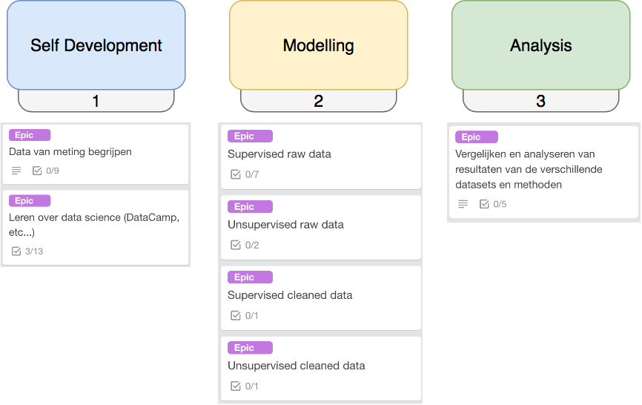
Approach
Notes:
We zijn nog steeds in de eerste fase. Data structuur is nu helder, rauwe data is afwezig.

Slide 3
Sprint planning
Sprint goal: The creation of a classifier
The two components:
Preparing data
Building the classifier
DataCamp & Coursera
Notes:
Eerst medische termen inzichtelijk gemaakt
Links/rechts = rechts/links
Cleaned data zijn berekende hoeken
Om de data beter te begrijpen hebben we ingezoomed op de Thorax sensor.

Slide 4
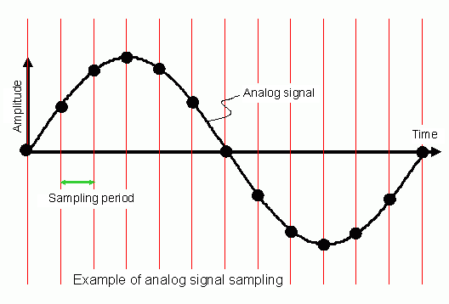
Preparing data
Setting test-data aside (10% - 90%)
Dealing with changing amount of ‘frames’ in each measurement (time series)
10% Testdata
2 Requirements:
Min 10% of patients are included
Min 10% of exercises are included
Random generator (excel)
All data
90% Remaining data
To be used for:
Training of models
Testing & choosing best model
Our approach:
Splitting the time series up in single samples
Result:
Csv 32 x 173621
Notes:
Eerst medische termen inzichtelijk gemaakt
Links/rechts = rechts/links
Cleaned data zijn berekende hoeken
Om de data beter te begrijpen hebben we ingezoomed op de Thorax sensor.

Slide 5
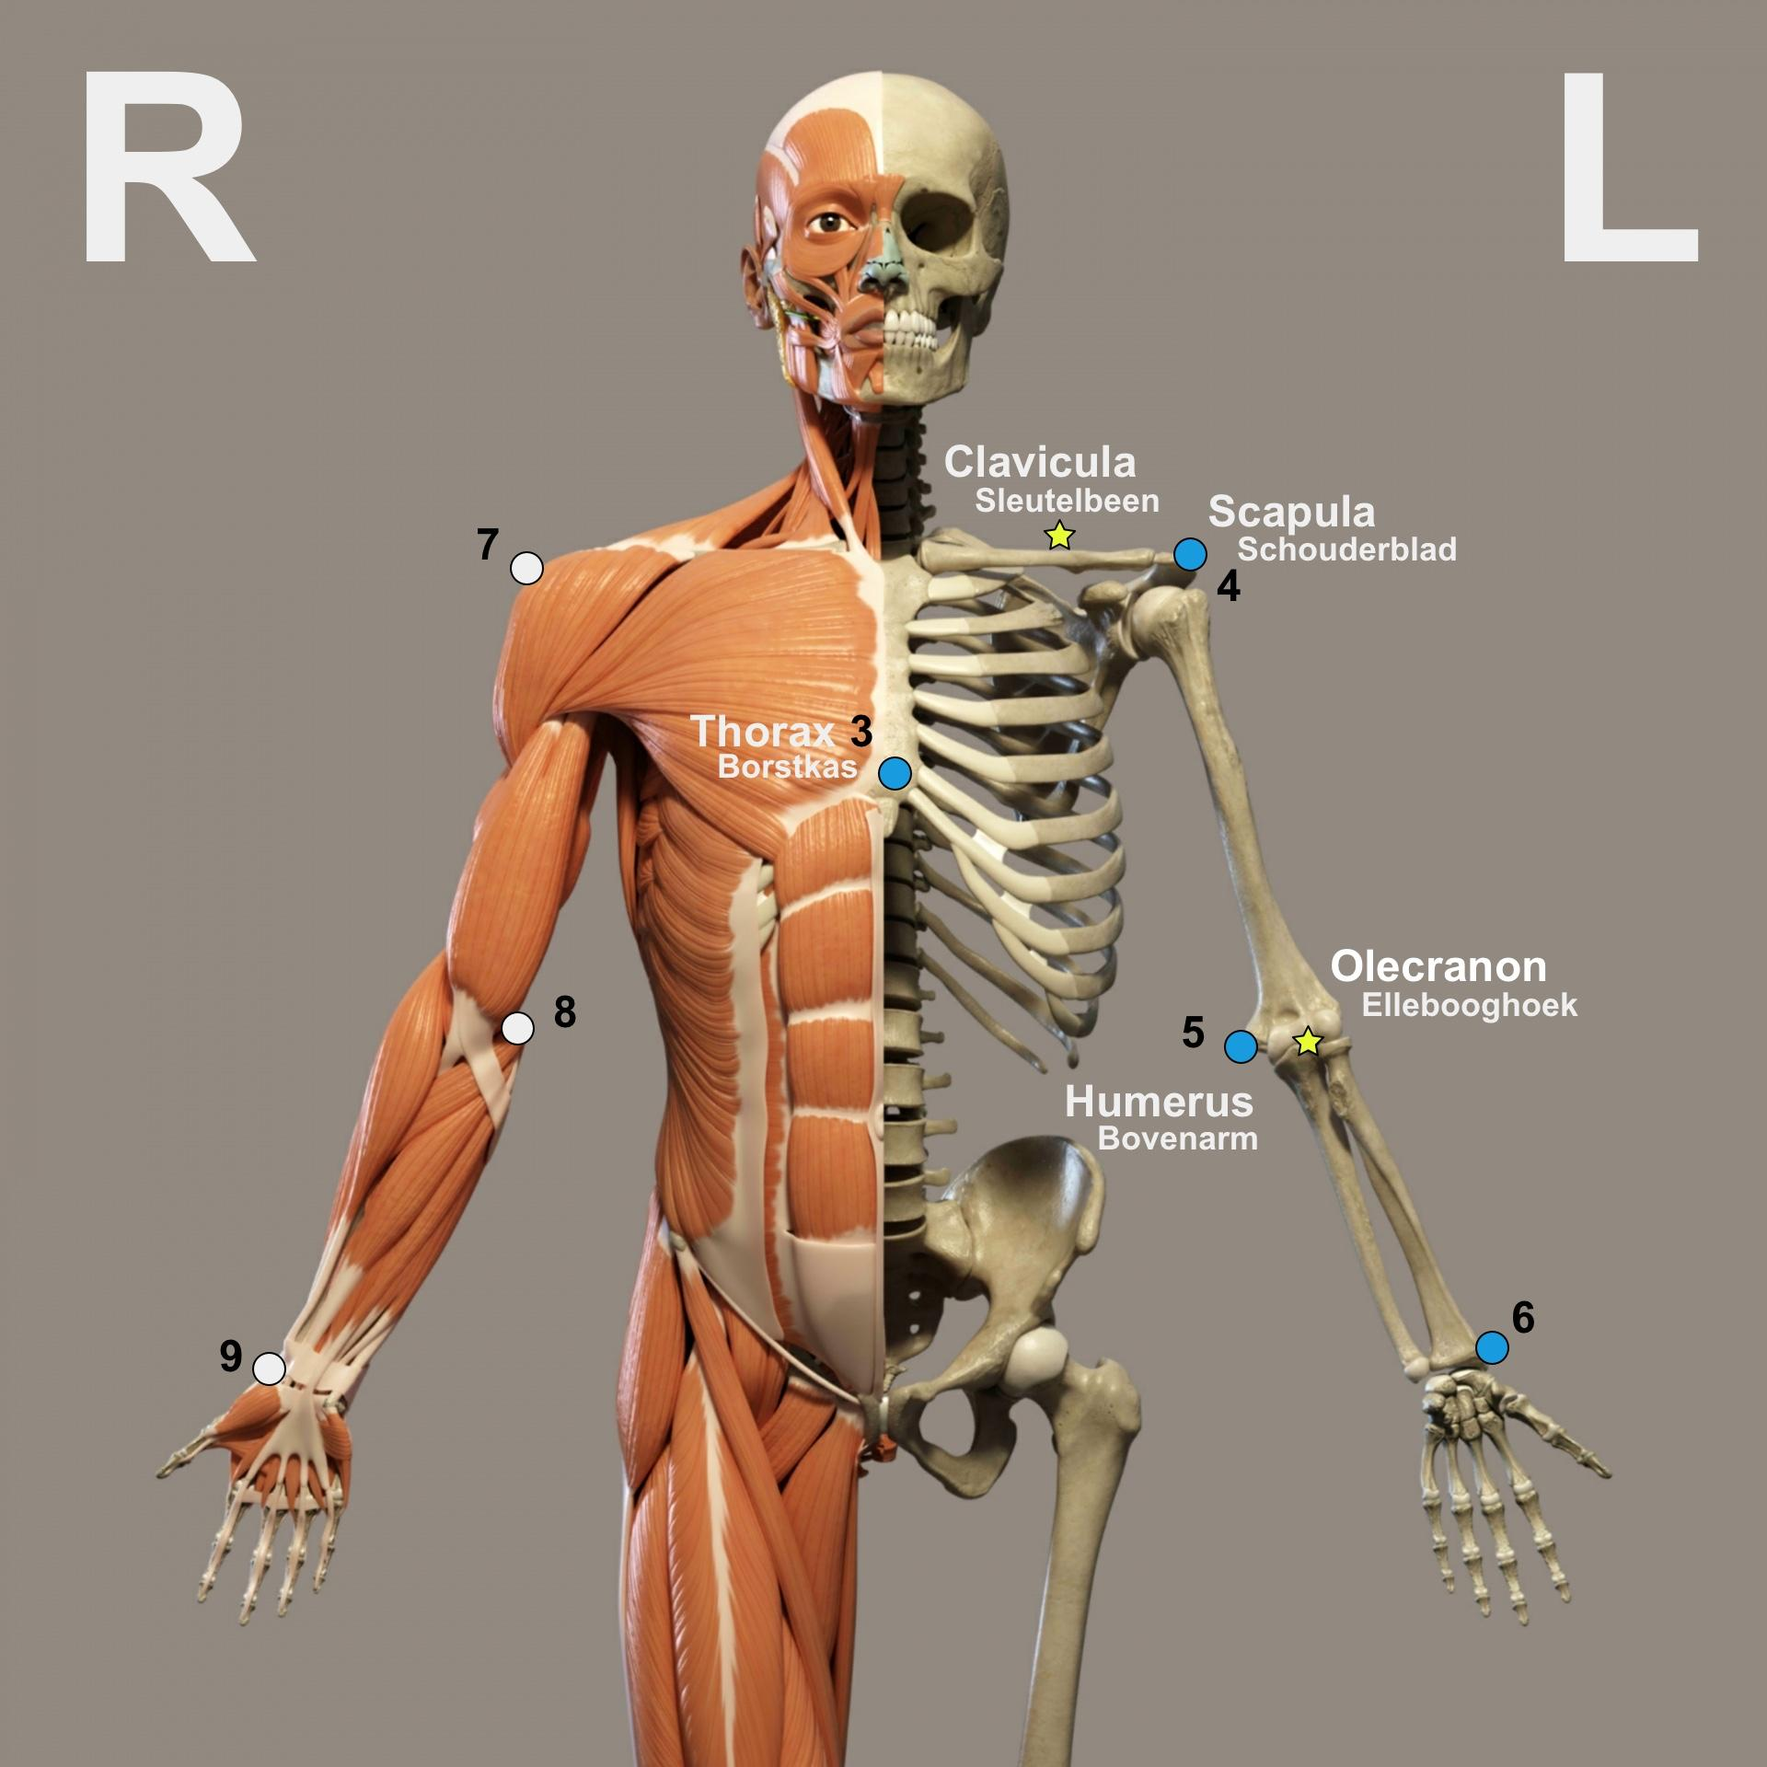
2. Building the classifier (next week)
Sprint goal: The creation of a classifier
Building a simple (but scaleable) classifier
Simple to validate the code
Adding more parameters to classifier (if possible)
Finishing DataCamp
Notes:
OOK VERTELLEN OVER DAT HET BELANGRIJK IS OM GOED NA TE DENKEN OVER WELKE PARAMETERS ER TOE MOETEN WORDEN GEVOEGD

Slide 6
What have we achieved this sprint?
Finished Coursera week 3
Builded a classifier
Only two features, as a test
Added differences in the left and right arm movement, as features
Using more features

Slide 7
Data structure
4 categories (= patient groups)
119 patients, unevenly divided in the 4 categories
21 different types exercises, not all exercises are present in all categories
1396 individual exercises.
191292 data samples, 26 features/parameters each
1st attempt: make a classifier to see if cat4 data samples can be distinguished from the other category samples. (The end goal is to classify patients, not individual data samples)

Slide 8
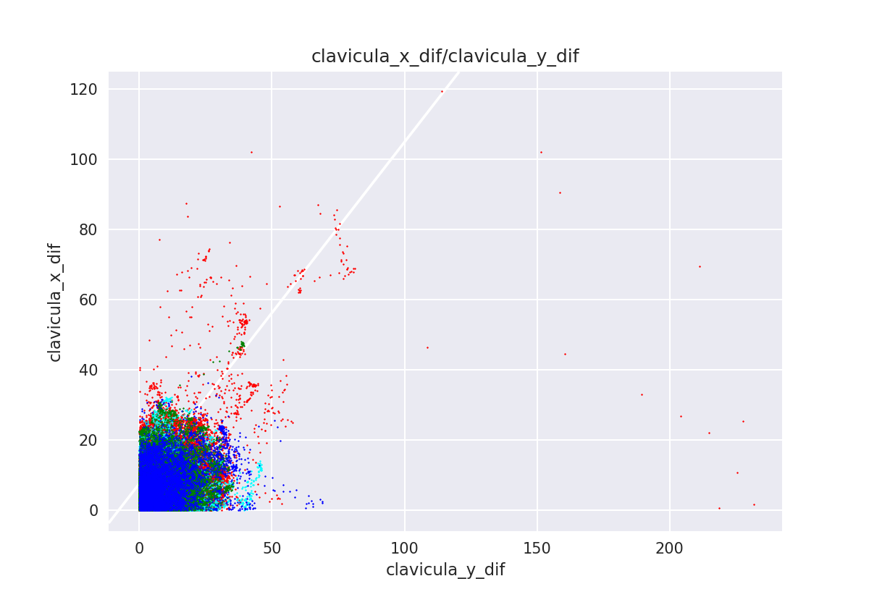
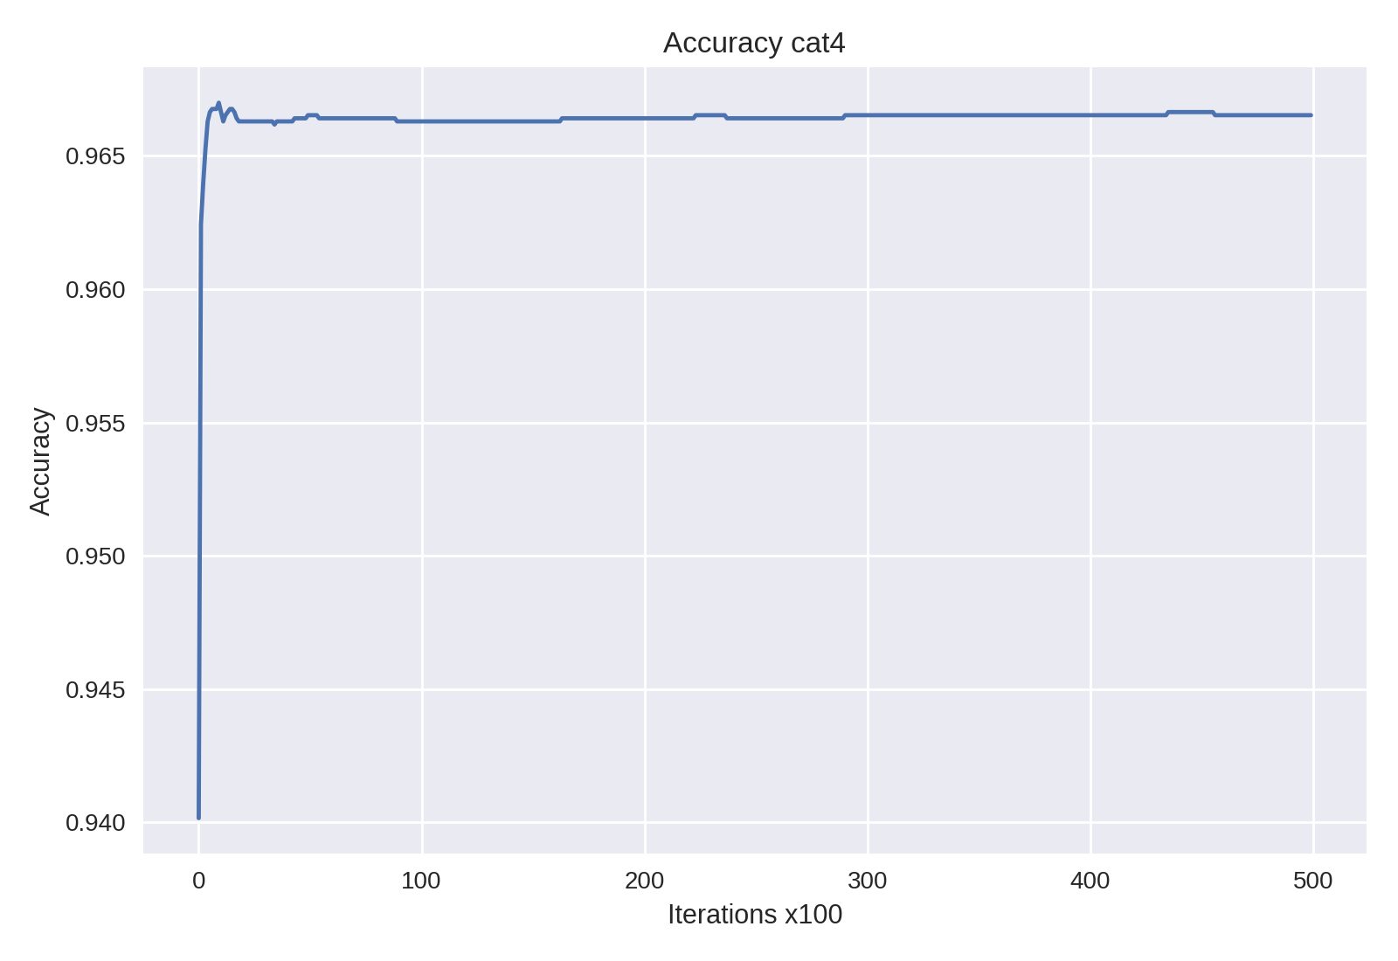
Result
 | pos | neg
Predicted pos | 650 | 119
Predicted neg | 1396 | 32151
resultaten op testset
recall 0.322 precision 0.845 accuracy 0.957
Model is trained on:
27 features
20% of the training dataset
Only 2 of the 27 features are plotted here!
Notes:
Van alle data is 10% apart gezet (vorige week uitgelegd).
Van de overige 90% is 1/20 gebruikt om een model te trainen. Deze resultaten zijn ook berekend over 20% van de overige data, maar wel een andere 20% dan waarop het model getraind is.

Slide 9
Result
 | Rest | Cat4 | percentage
pat
4006.0 | 356.0 | 569.0 | 61.513.514
4023.0 | 423.0 | 653.0 | 60.687.732
4014.0 | 625.0 | 424.0 | 40.419.447
4015.0 | 530.0 | 219.0 | 29.238.985
4012.0 | 724.0 | 297.0 | 29.089.128
4011.0 | 539.0 | 218.0 | 28.797.886
4020.0 | 1389.0 | 412.0 | 22.876.180
4024.0 | 908.0 | 236.0 | 20.629.371
4017.0 | 1402.0 | 199.0 | 12.429.731
3031.0 | 1957.0 | 170.0 | 7.992.478
3008.0 | 3250.0 | 130.0 | 3.846.154
3021.0 | 2236.0 | 77.0 | 3.329.010
2006.0 | 2373.0 | 75.0 | 3.063.725
Last sheet was on sample basis.
What if we summarize all samples per patient?
All cat4 patients have more than 10% of samples classified as Cat4.
(Other patents van less than 10% classified as cat4)
Cat 4 patients

Slide 10
What have we planned?
Meeting with de Groot (LUMC) to make a measurement ourselves
Classifying with more meaningful features / results
Tackling the issue of samples frequention

Slide 11
The problems we face or expect to face
Memory error on full dataset/parameters
Slow on bigger datasets
Deciding what is meaningful information
Receiving the raw data
Notes:
Sample = niet consitent
Regressie = niet gemaakt voor tijdgevoelige informatie

Slide 12
Any questions or suggestions?

